Slide 1
ROUNDTABLE ON FINANCING WATER PROJECTS IN ARAB COUNTRIES
FEBRUARY 9-10, 2026
Kuwait City, Kuwait

Slide 2
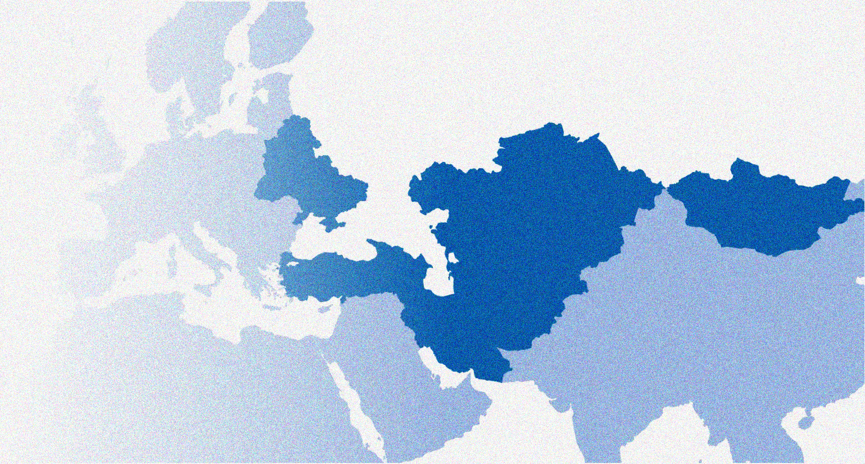

Kuwait Fund for Arab Economic Development
Contributions & Impact in
Water & Sanitation Sector in the Arab Region
Eng. Manar Mansour

Slide 3

Presentation Outline
    Introduction.
    Water Sector.
    Financing water projects in Arab countries.
    Key-Challenges facing water sector.
    Water Supply solutions.
    Climate-resilience & water financing.
    Wastewater treatment and reuse.

Slide 4

Kuwait Fund for Arab Economic Development
    Kuwait Fund is the first development institution in the world to be established by a developing country.
    Strong focus on Arab countries.
    Concessional loans & grants.

Slide 5
Kuwait Fund for Arab Economic Development
    Kuwait Fund is the first development institution in the world to be established by a developing country.
    Strong focus on Arab countries.
    Concessional loans & grants.

Slide 6
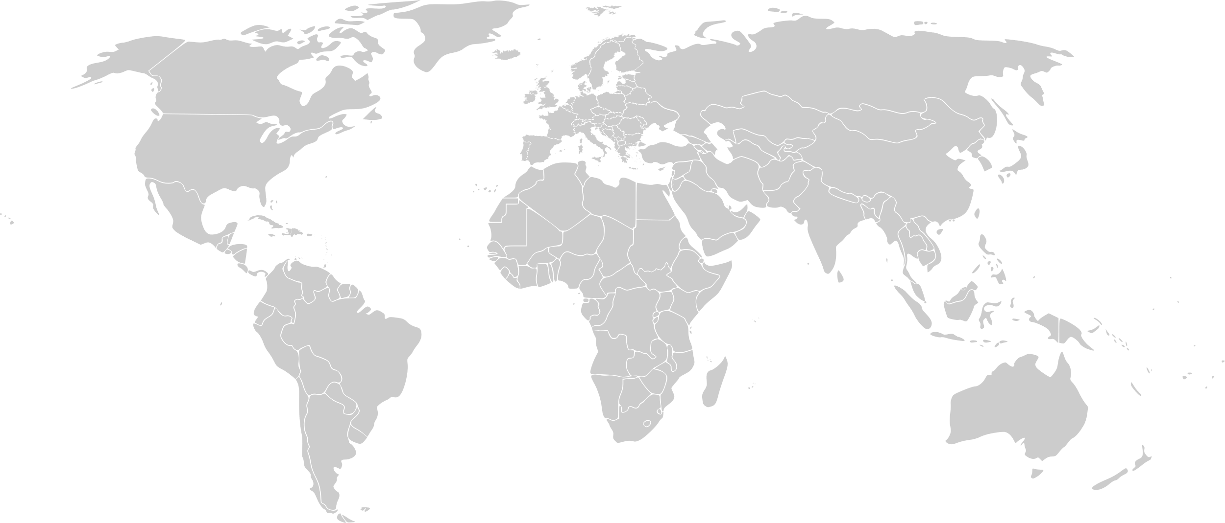



Expansion of the Fund's scope of work
In 1974, the Fund's scope of work was expanded to span the entire globe – a shift from the exclusive focus on Arab countries

Slide 7
Geographical Distribution
Total Number of Countries | 107
Total Number of Loans | 1038
Total Amount of Loans | $22.4 B
Total Number of Grants | 464
Total Amount of Grants | $1.3 B
Water & Sanitation, Agriculture, Energy, Transportation, Social including: Health & Education …

Slide 9
Water Sector: A Strategic Priority
    Priority sector to the Kuwait Fund.
    High relevance in Arab countries.
    Water supply & sanitation.
    Public health & water security.

Slide 10
Financing Water Projects in Arab Countries
    Water projects financed in 13 Arab countries.
    Loans for water infrastructure. (overall $3.33 B)
    Grants for technical assistance.
            In Arab Countries 72%.
Total Number of Loans | 52
Total Amount of Loans | $2.18 B
Total Number of Grants | 8
Total Amount of Grants | $5.8 M

Slide 11
Key Challenges Facing Water Sector
    Water scarcity.
    Groundwater depletion.
    Deteriorating water quality.
    High energy costs.
    Climate change impacts.

Slide 12

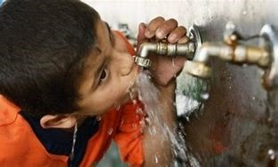
Project Design: From Source to Size
    Feasibility study as foundation.
    Identification of water source.
    Assessment of quantity & quality.
    Project size linked to beneficiaries & cost.

Slide 13
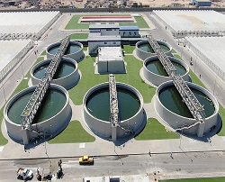
Water Supply Solutions
    No surface water → Boreholes.
    Surface water available → Treatment based on quality.
    Treatment options:
      Simple treatment.
      Advanced treatment.
      Desalination (Thermal / RO).

Slide 14
Climate Resilience & Water Financing
    Climate change affects water availability.
    Increased droughts & rainfall variability.
    Higher stress on infrastructure.
    Climate-resilient projects.

Slide 15

Wastewater Treatment & Reuse
    Essential components of integrated water management.
    Reliable, climate-independent water source.
    Reduced pressure on freshwater.
    Environmental protection.
    Enhancing public health and sustainability.

Slide 16

Conclusion & Way Forward
    Integrated water solutions (water availability, quality, technology…)
    Climate-resilient financing.
    Tailored to country needs.
    Comprehensive feasibility studies.
    Long-term development impact.

Slide 17
Thank You …
For any additional information related to the Kuwait Fund, visit the official website
www.kuwait-fund.org

