Slide 1





ACWA –
Leadership in Water Desalination
Sawan Kumar, ACWA Power
ROUNDTABLE ON FINANCING WATER PROJECTS IN ARAB COUNTRIES
FEBRUARY 9–10, 2026
ARAB FUND HEADQUARTERS, KUWAIT CITY

Slide 2
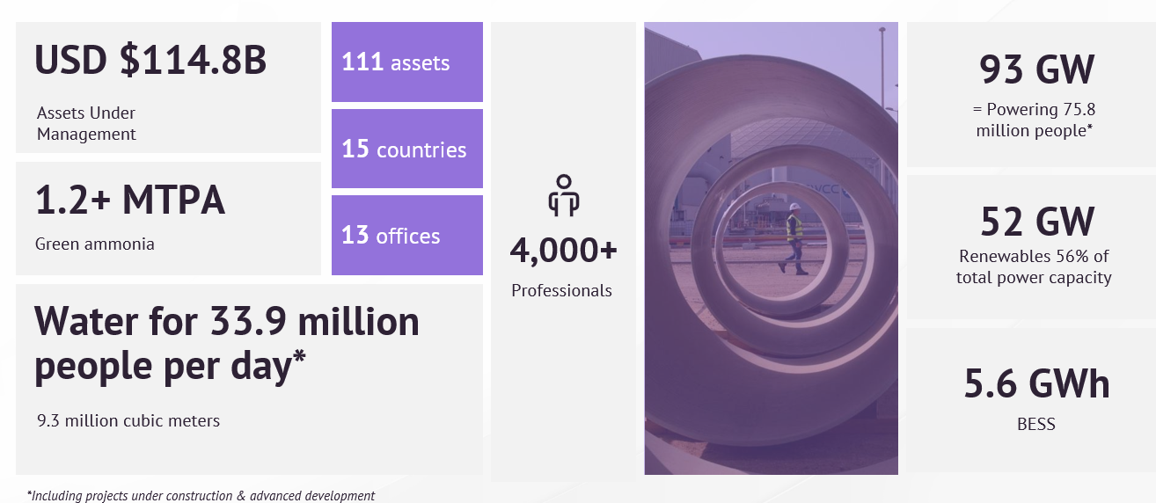
ACWA – Our Impact In A Snapshot
By creating value and driving progress for people and the planet, we create lasting impact:
ROUNDTABLE ON FINANCING WATER PROJECTS IN ARAB COUNTRIES

Slide 3
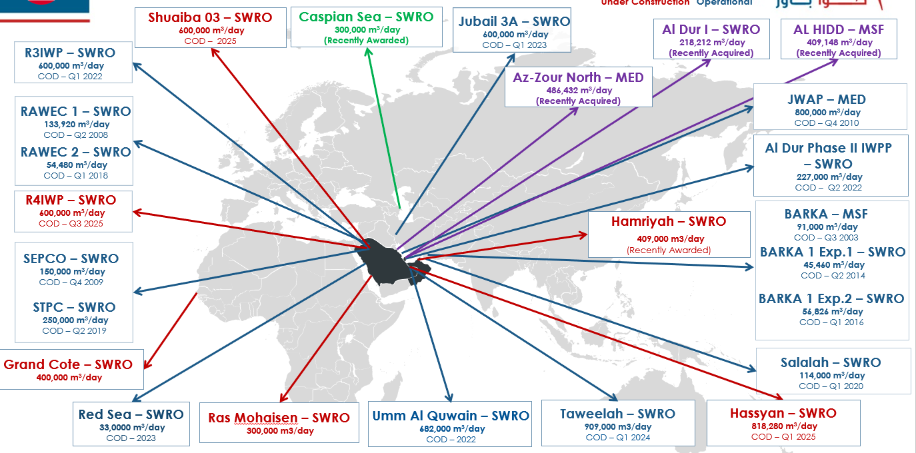
ACWA – Desalination Assets
Under Construction
Operational
ROUNDTABLE ON FINANCING WATER PROJECTS IN ARAB COUNTRIES

Slide 4
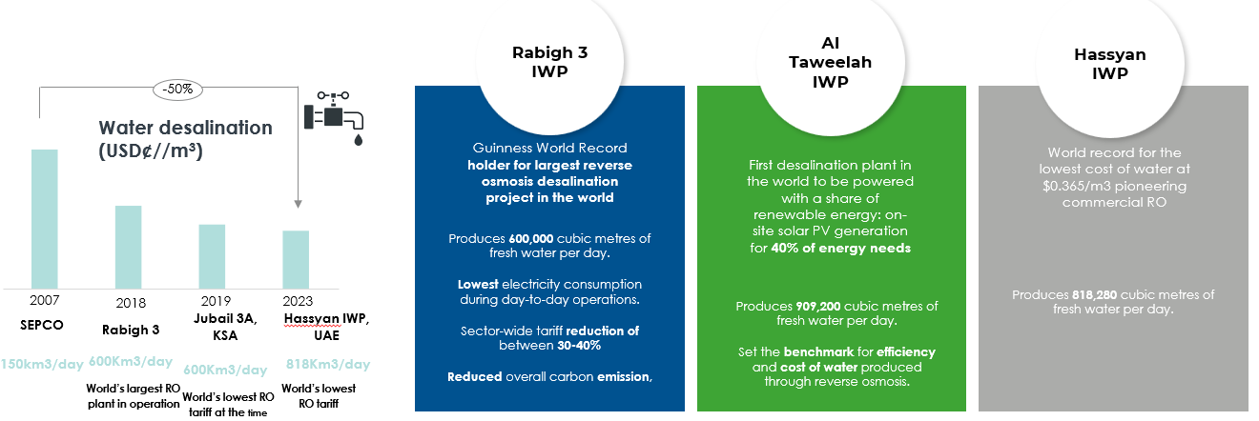
Providing the Lowest Cost of Desalination – Champion in Cost-Effective, Low Carbon-Intensive Technologies
ACWA Power has reduced levelized water cost by almost 50% since 2007 by:
Continuous innovation, always using latest - yet proven – technologies and enhanced plant design
A Life Cycle Cost Analysis rather than focusing on CAPEX only, based on our strong operational experience and ability to reduce O&M costs
Continuous reduction of Specific Power Consumption (kWh/m³), by optimized membrane configuration, plant design and solar PV integration
ROUNDTABLE ON FINANCING WATER PROJECTS IN ARAB COUNTRIES

Slide 5
Key Considerations
Affordability
PPP Framework
Access to Concessional Funds
Bankable Offtake Structure
ROUNDTABLE ON FINANCING WATER PROJECTS IN ARAB COUNTRIES

Slide 6
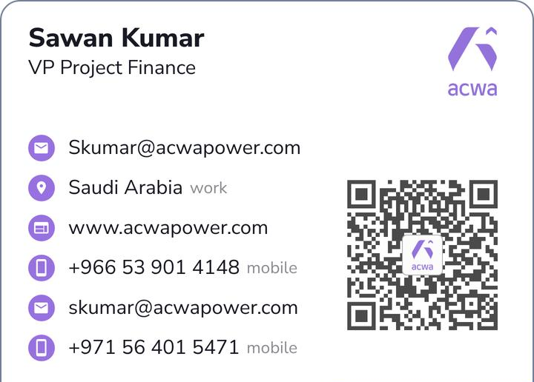


Thank you
Name:
Position:
Company
Email:

