Slide 1
ROUNDTABLE ON FINANCING WATER PROJECTS IN ARAB COUNTRIES
FEBRUARY 9-10, 2026
Kuwait City, Kuwait
Session II - MDB and DFI Perspectives on Financing Water Security

Slide 2




EU financing toolkit for Egypt’s water sector
From technical assistance to scaled investment (grants • blending • guarantees)
What each instrument buys (and when to use it)
Investment grants
Technical assistance
Reduce affordability gaps and improve access; ideal where tariffs cannot cover full costs.
Reforms + project preparation: feasibility, safeguards, procurement readiness, performance plans.
Blending
Guarantees (EFSD+)
Combine grants with loans to leverage larger volumes of EIB/EBRD/MDB finance (e.g., NIP).
Risk-sharing to mobilise investment under Global Gateway / Team Europe priorities.
Egypt water “bankability spine” (what financiers look for)
Clear sector strategy + reform pathway (incl. utility performance)
Credible CAPEX/OPEX, affordability and funding plan
Climate resilience + social safeguards + delivery readiness
Sources: EFSD+ / Global Gateway instruments; NIP blending overview.
Notes:
[Sources]
- European Commission: EFSD+ overview (guarantees/blending under Global Gateway): https://international-partnerships.ec.europa.eu/funding-and-technical-assistance/funding-instruments/european-fund-sustainable-development-plus_en
- EIB: Neighbourhood Investment Platform (NIP) overview: https://www.eib.org/en/products/mandates-partnerships/nip/index
[/Sources]

Slide 3

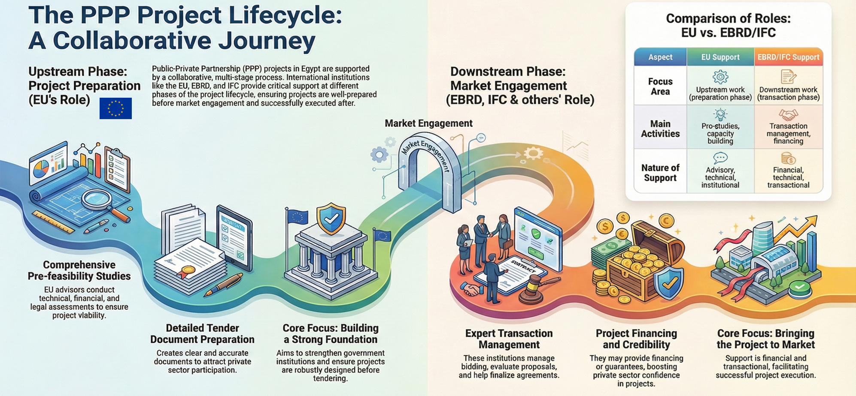
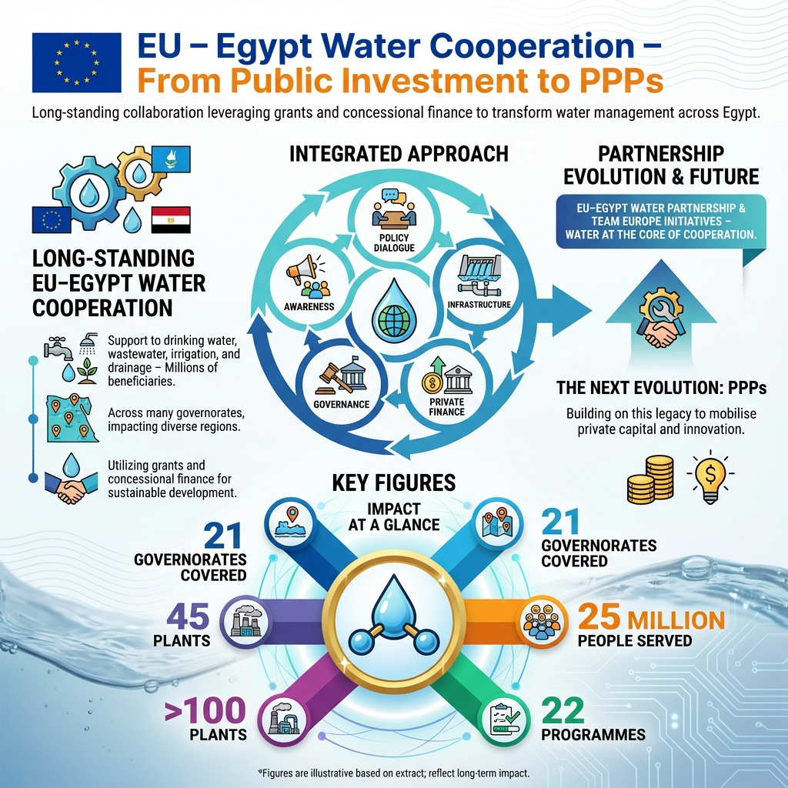
Egypt proof points: EU support unlocking larger finance
Two wastewater cases combining EU grants with major lender finance
Example 1
Example 2
Fayoum Wastewater Expansion Programme
Alexandria West WWTP upgrade & expansion
EU grant + major EIB/EBRD financing (blended package)
Focus: scale sanitation access + system performance
Lesson: reforms + delivery plan strengthen bankability
EIB financing + EU grant contribution (€20m)
Focus: upgrade/expand treatment and networks
Lesson: clear scope + safeguards + procurement readiness
EU grant • Loans (EIB/EBRD)
EU grant • EIB loan
Sources: EU press release (Fayoum); EIB press release (Alexandria West).
Notes:
[Sources]
- European Commission press release on Fayoum wastewater expansion (EU grant with EIB/EBRD): https://europa.eu/rapid/press-release_IP-17-4222_en.htm
- EIB press release on Alexandria West WWTP (EIB financing + EU grant contribution): https://www.eib.org/en/press/all/2020-045-egypt-the-eu-bank-finances-the-upgrade-and-expansion-of-alexandria-west-wwtp
[/Sources]

Slide 4





How to build a bankable dossier (and engage Team Europe)
A practical path for MWRI • MHUUC/HCWW • MoF + EU financiers
Five-step ladder (from concept to financed pipeline)
Align
• 2–3 page concept note
• CAPEX/OPEX + funding plan
• NRW/efficiency measures
• Climate & social safeguards
• Procurement & readiness
• Risk matrix + mitigation
Minimum dossier
contents
Fit with sector strategy; confirm roles across MWRI, MHUUC/HCWW, MoF.
Prove
Feasibility + CAPEX/OPEX; affordability; climate & social safeguards.
Structure
Select mix: grant / blending / guarantee; define procurement & readiness.
Engage early
EU Delegation + IFIs with a 2–3 page concept note + data room index + EGY Debt com.
Convert
EU4Water can help
beyond classic TA
Use EU4Water to package reforms + investment; move to IFI appraisal.
Pipeline screening • dossier templates • reform–investment packaging • introductions to financiers
Sources: Funding & Tenders portal; EFSD+ overview (Global Gateway).
Notes:
[Sources]
- European Commission Funding & Tenders (calls database): https://ec.europa.eu/info/funding-tenders/opportunities/portal/screen/opportunities/calls-for-proposals
- European Commission: EFSD+ overview (guarantees/blending under Global Gateway): https://international-partnerships.ec.europa.eu/funding-and-technical-assistance/funding-instruments/european-fund-sustainable-development-plus_en
[/Sources]

