Slide 1
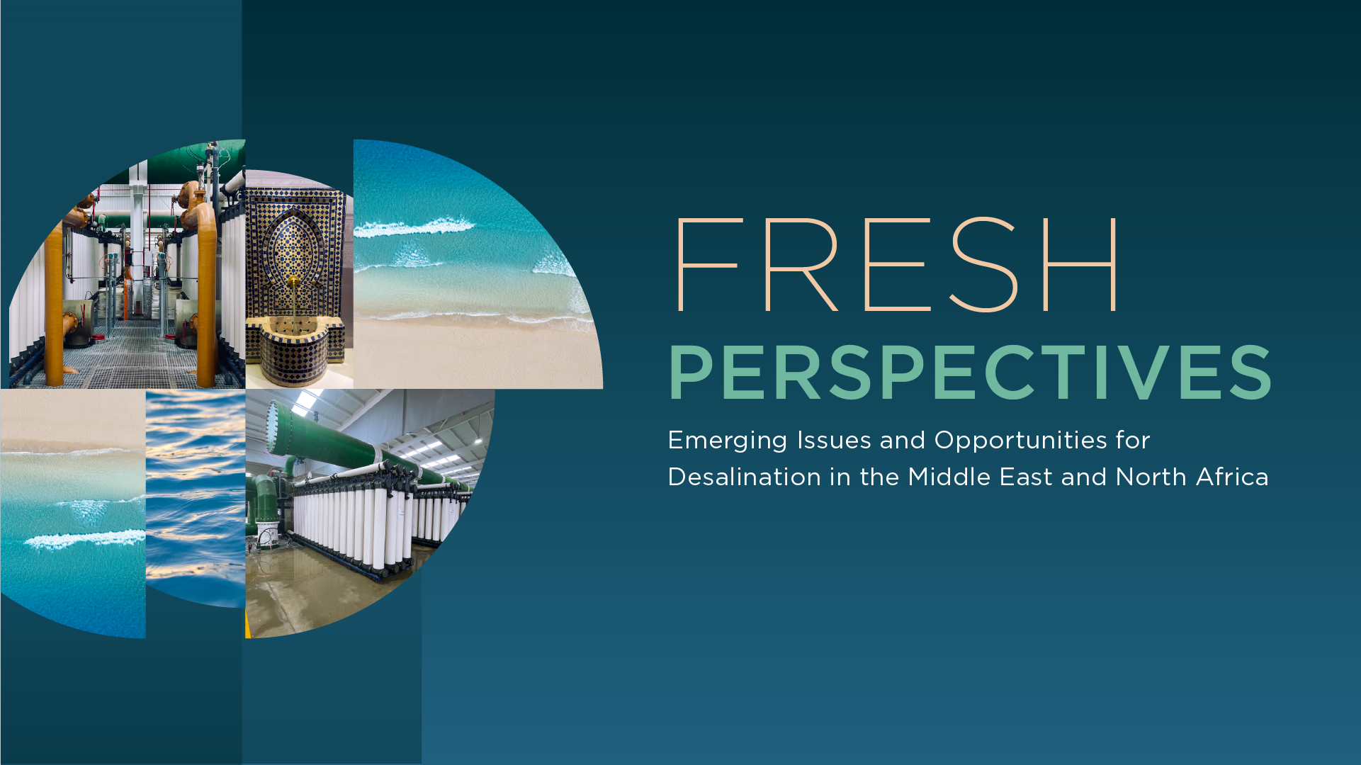

FEBRUARY 2026
Notes:
Add title slide including the paper cover page and space foreseen for highlighting presentation event, date, presenter name etc

Slide 2





Desalination is emerging as a vital adaptation strategy across the Middle East and North Africa region, but mainstreaming requires country-specific pathways, notably for middle- and low-income countries.
PILLARS FOR SUCCESSFUL, SUSTAINABLE DESALINATION
Technological Innovation
Energy Efficiency + Renewable Energy
Environmental +
Social Management
Sector Governance
+ Integrated Water Resources Management
Financial
Sustainability
Transforming desalination through greater accessibility and cost-effectiveness
For cost-effective desalination, and climate change mitigation
To harness desalination benefits while protecting ecosystems and communities
Backbone for successful, sustainable desalination at scale
To expand desalination without compromising equity or fiscal stability of water sector

Slide 3
Desalination is emerging as a vital adaptation strategy across the Middle East and North Africa region, but mainstreaming requires country-specific pathways, notably for middle- and low-income countries.
PILLARS FOR SUCCESSFUL, SUSTAINABLE DESALINATION
Sector Governance
+ Integrated Water Resources Management
Financial
Sustainability
Backbone for successful, sustainable desalination at scale
To expand desalination without compromising equity or fiscal stability of water sector

Slide 4
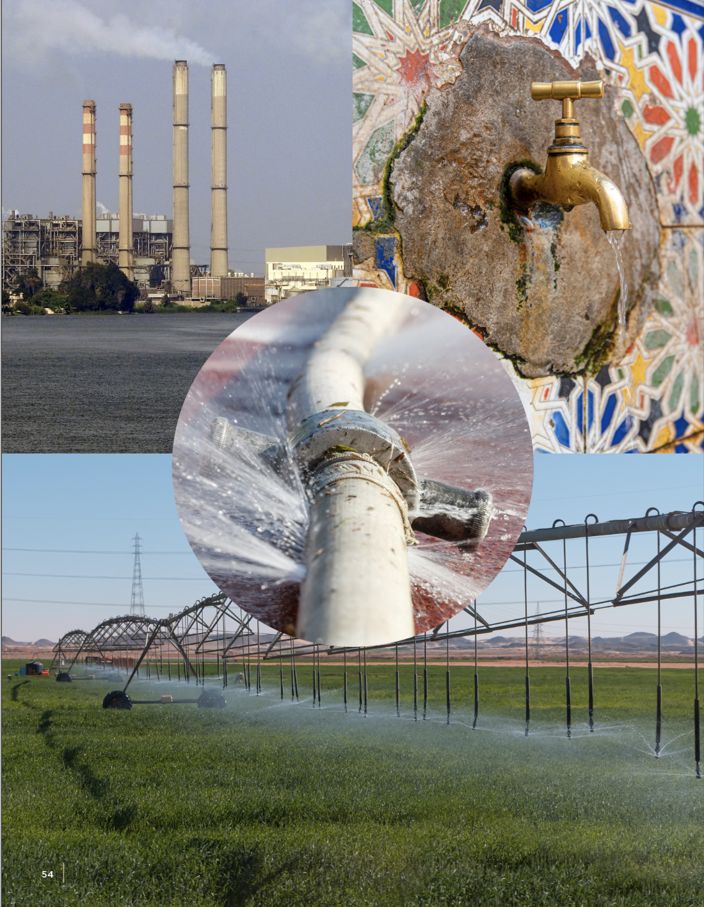
Strong Sector Governance and IWRM

Slide 5
Governance Adjustments to Mainstream Desalination
Scale and pace of desalination development, especially in the Middle East and North Africa, have important implications for overall governance of water, notably in terms of:
Institutional Structures and
Management Models
Integrated Water Resources
Management (IWRM)
Public–Private Partnerships (PPPs)

Slide 6
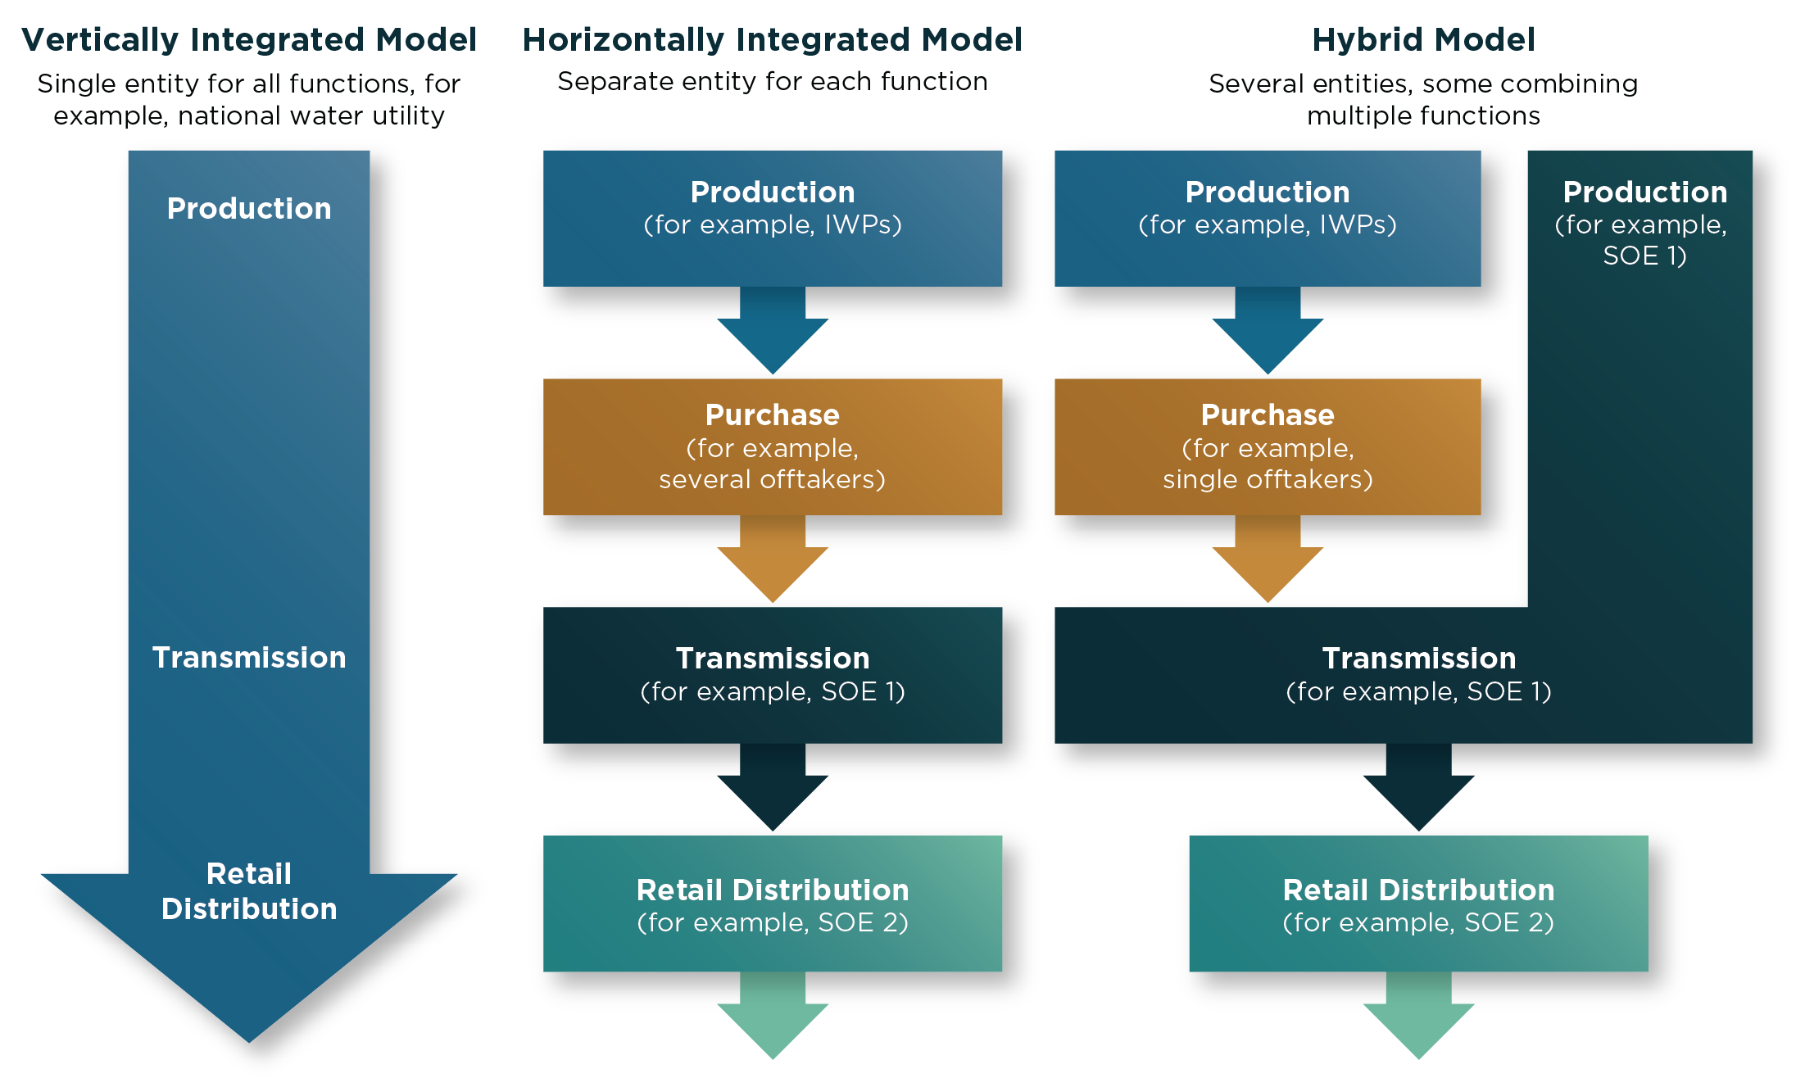
Fit-For-Purpose Institutional Structures and
Management Models for Water Service Delivery
Examples of Institutional Models for Water Service Delivery
Mainstreaming desalination may require adapting or updating the roles and responsibilities for key water service delivery functions.
Vertical, horizontal, and hybrid delivery models all have (dis)advantages. The success of any model is highly context-specific and dynamic—there is no one-size-fits-all approach.

Slide 7
Embedding Desalination into IWRM
IWRM
Demand Management and Efficiency Improvement
Capital Investment Plans
Supply Investments (incl. Desalination)
Improved Governance and Operator Performance
Improve Allocation
Reduce Losses and
Manage Demand
Maximize Reuse
Amplify Desalination
$
The Simulation and Portfolio Optimization Tool (SPOT) can help planners work out the most cost-efficient mix of water supply projects that deliver the desired reliability level. SPOT also assesses trade-offs between desalination and wastewater reuse.
$$
$$$
$$$$
Water Security and Return on Investment
Notes:
For water security and return on investment, desalination must be part of an IWRM strategy that balances supply-side investments with comprehensive demand-side management, capital investment plans, and improved sector governance.
Scaling desalination is a last resort rather than a substitute for IWRM. Lower-cost solutions to manage water demand, reduce water losses, improve water allocation, and maximize wastewater reuse must first be exhausted.

Slide 8
Effective Governance for Desalination PPPs
Clear frameworks and mandates that delineate responsibilities for planning, procurement, ownership, payment, regulation, and monitoring across the water value chain.
Institutional models and risk allocation commensurate with capacity, creditworthiness, and market depth.
Competitive, transparent procurement, and robust contract structuring and management, to safeguard public interest while stimulating performance and creating predictable financial flows.

Slide 9
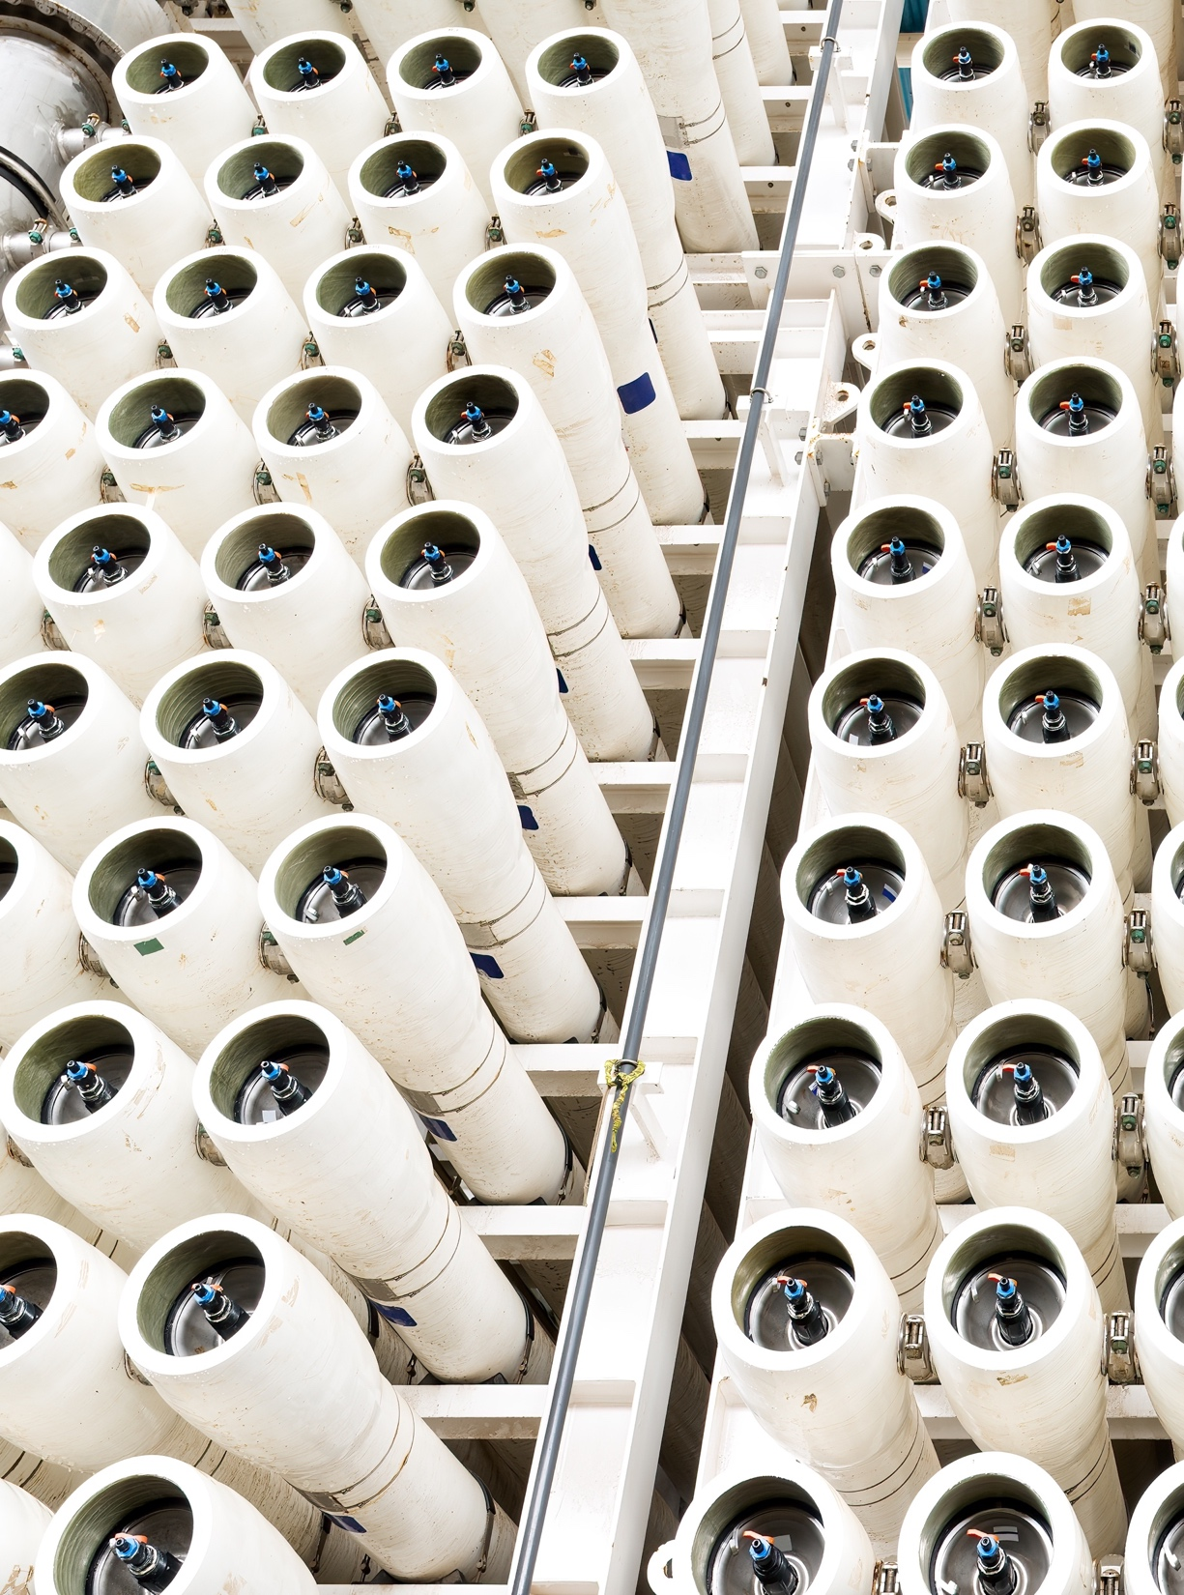
Financial Sustainability

Slide 10
Addressing the Financial Challenges of Desalination
Financial sustainability of desalination is required at three levels.
Entire Sector
Individual Projects
Vulnerable Households

Slide 11
Sector-Wide Financial Sustainability
In many MICs and LICs in the region, expensive desalination combined with the financial vulnerability of many water service providers creates large fiscal risks.
Integrating national desalination programs within broader water sector planning strategies can help optimize the required capacity and control costs.
Appropriate fiscal policies and economic regulation can help achieve cost recovery and minimize the fiscal impact of increased desalination.
Regulation of related sectors—especially energy—may also shape the viability, cost, and environmental impact of desalination initiatives.

Slide 12
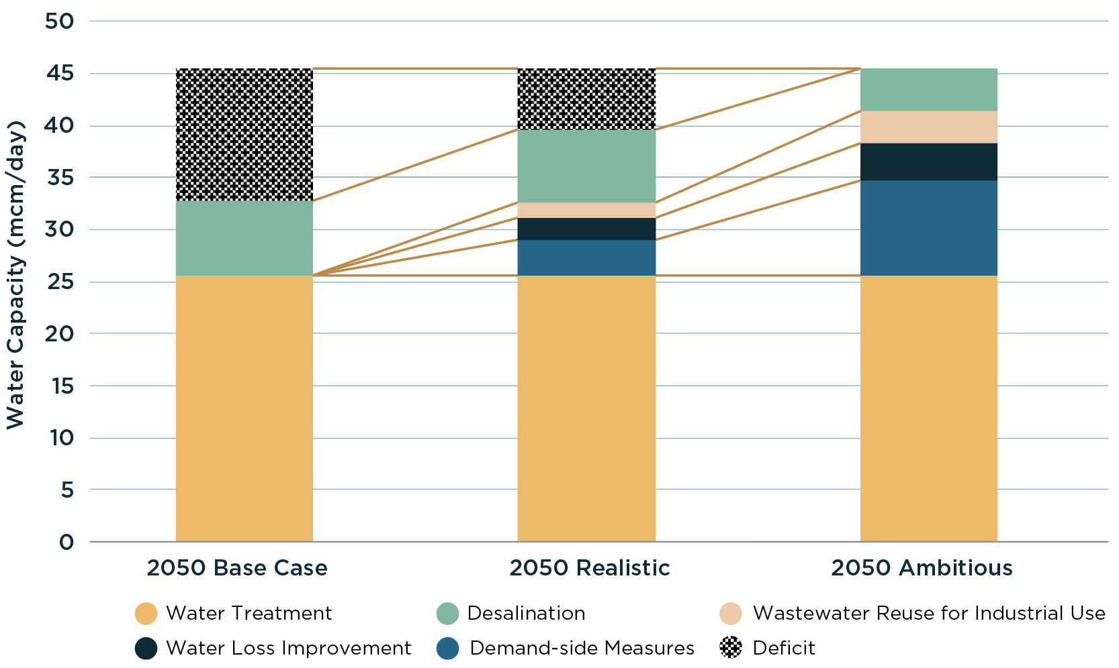
Country Example: Sector Reforms for Financial Sustainability
Demand-Side and Supply-Side Measures to Manage Water Demand in 2050
In the Arab Republic of Egypt, sector reform measures in four areas—IWRM, demand-side management, operational efficiency, and regulatory and institutional improvements—could help save about 2.33 BCM of water per year by 2050. In turn, this could reduce desalination CAPEX by US$5.5 billion and annual OPEX by US$500 million.

Slide 13
Financing Desalination Projects
Mobilizing private finance typically requires either bankable projects or bankable utilities—largely absent in most MICs and LICs in the Middle East and North Africa.
Public authorities must carefully design desalination projects and select delivery models that maximize value for money in their context.
  1
  2
Scaling desalination finance requires MICs and LICs in the region to foster a broader enabling environment that reduces risks and attracts diverse investors.
Beyond enabling reforms, public finance can be deployed directly to derisk projects and reduce the cost of capital, thereby enhancing project bankability and affordability.
  3
Type and degree of private sector participation highly varies across the region by project scale, type, and sector and country contexts, ranging from IWP, BOO, and BOT to DBO, hybrid contracts, and EPC.
  4

Slide 14
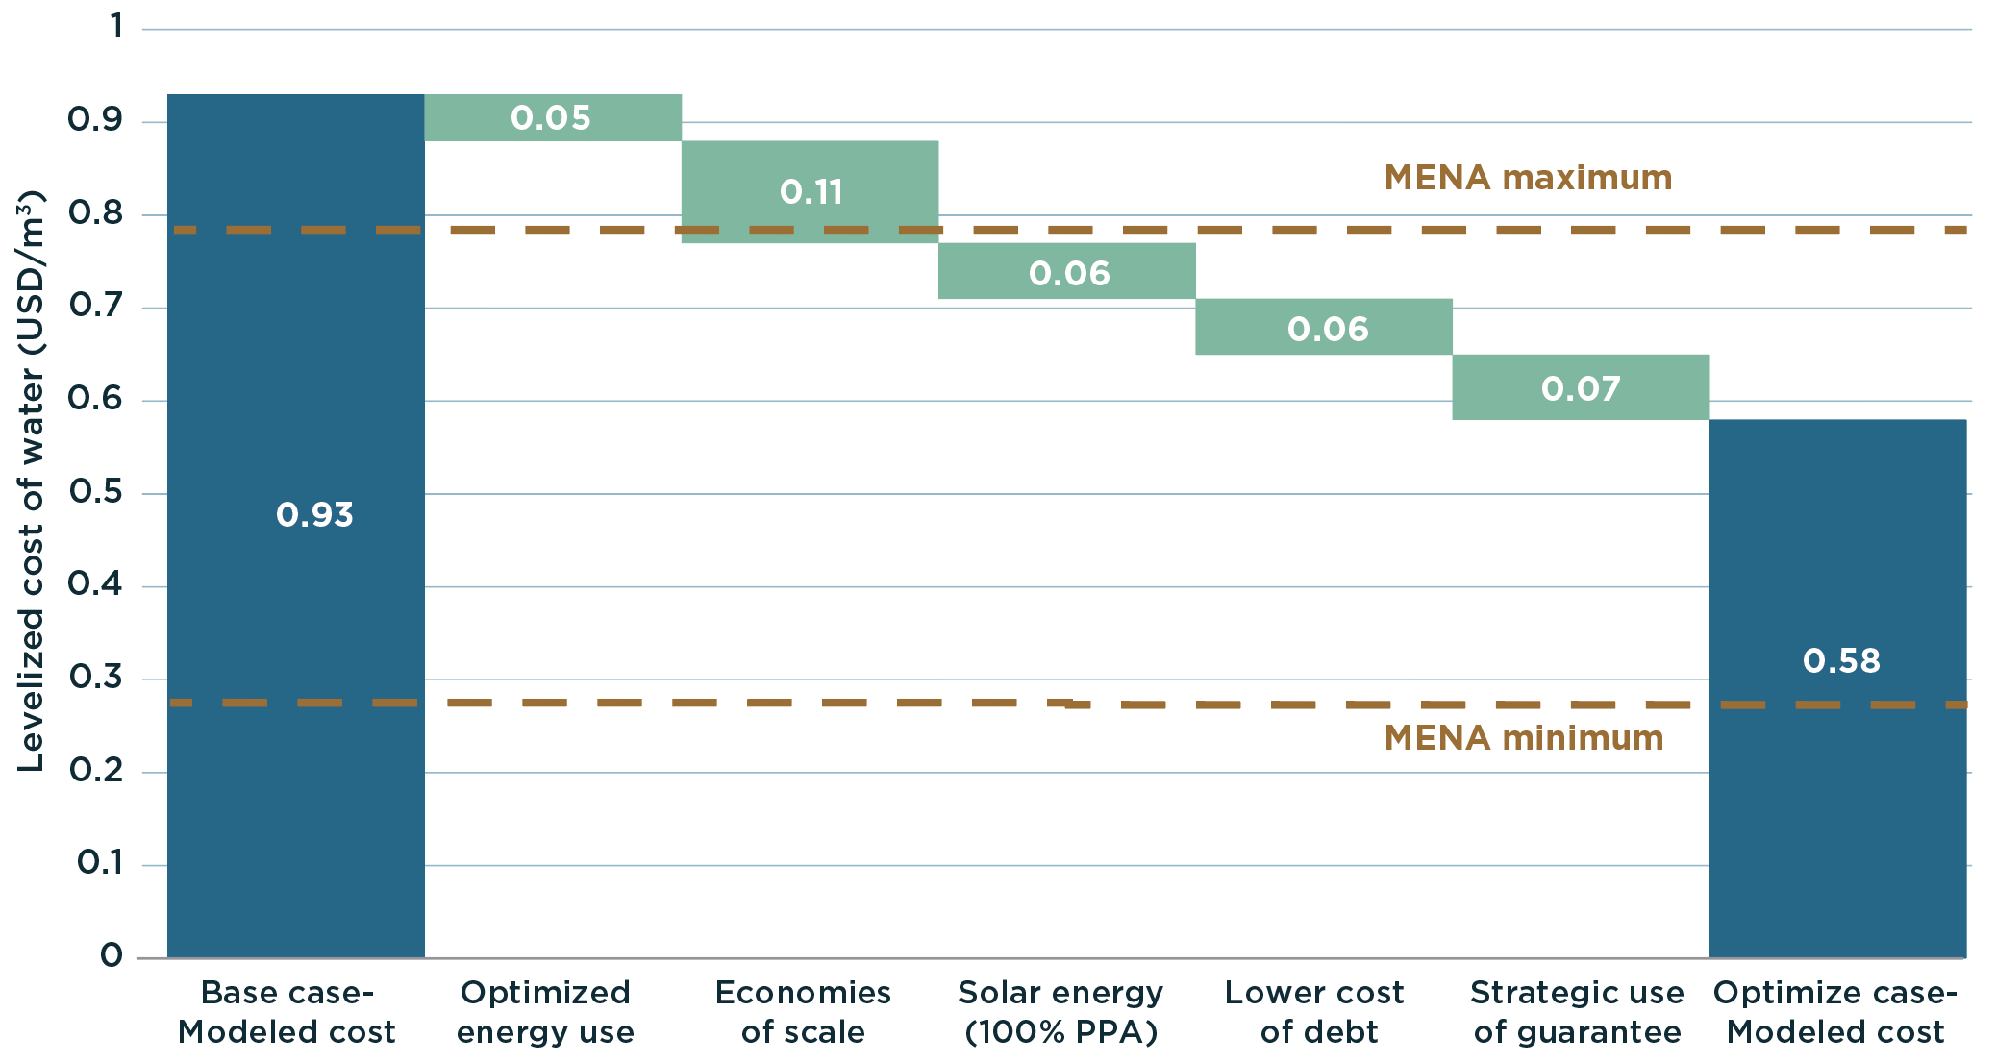
Country Example: Structuring Measures for Increased Bankability
Impact of Various Financial Structuring Measures on Desalination Cost
Innovative structuring of desalination transactions can substantially reduce the cost per m³ of desalinated water and increase bankability, as illustrated for the Arab Republic of Egypt.

Slide 15
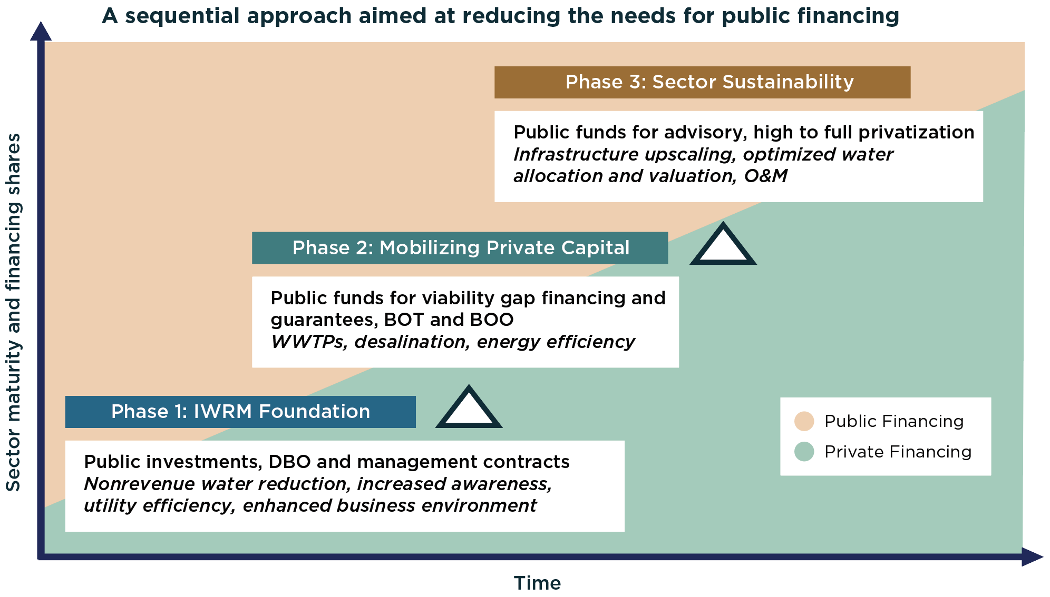
Example: Programmatic Approaches to Water Security
Stylized Integrated Water Resource Management with Gradual Transition from Public to Private Financing
Achieving financial sustainability of desalination at sector, project, and household level can be operationalized through holistic IWRM programs.
A phased approach lets governments secure quick wins for water security while paving the way for complex, private sector- driven activities.
International financial institutions such as the World Bank Group can support this trajectory through a variety of financing instrument types and advisory services.

Slide 16


